Slide 1


Slide 2
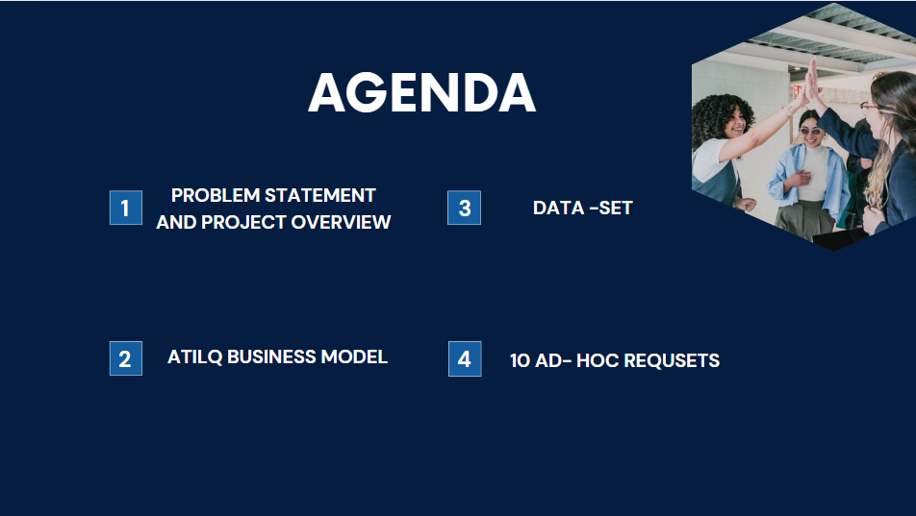


Slide 3
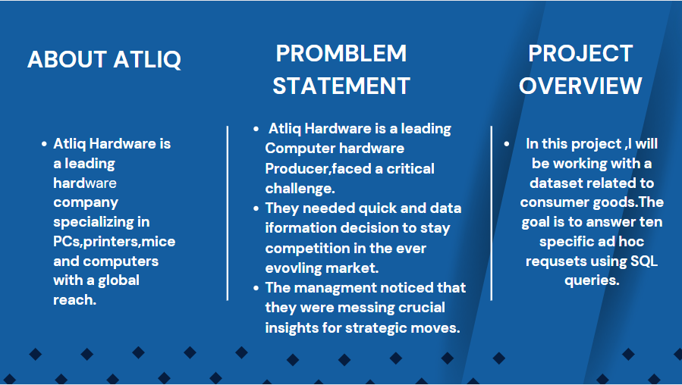

Slide 4

Atliq hardware - business model
Brick & Mortar
Croma
Best Buy
E-Commerce
Amazon
Flipkart
Customers Platforms
Customer Channel
Customers
Croma
Best Buy
Staples
Flipkart
retailer
Croma
Amazon
Direct
Atliq (e–Store)
Atliq(exclusive)
Distributer
NEPTUNE

Slide 5
Atliq hardware - business model
PC
Personal Laptop
Gaming laptop
N&S
Wifi Extenders
USB Flash Drives
Product Division
P&A
Processors
Motherboard
Keyboard
Mouse
Product Segment
Storage
Notebook
Peripherals
Networking
Desktop
Accessories

Slide 6
Data - Set
Database
Table
dim_customer
dim_product
fact_gross_price
fact_manufacturing_cost
fact_pre_invoice_deductions
fact_sales_monthly

Slide 7
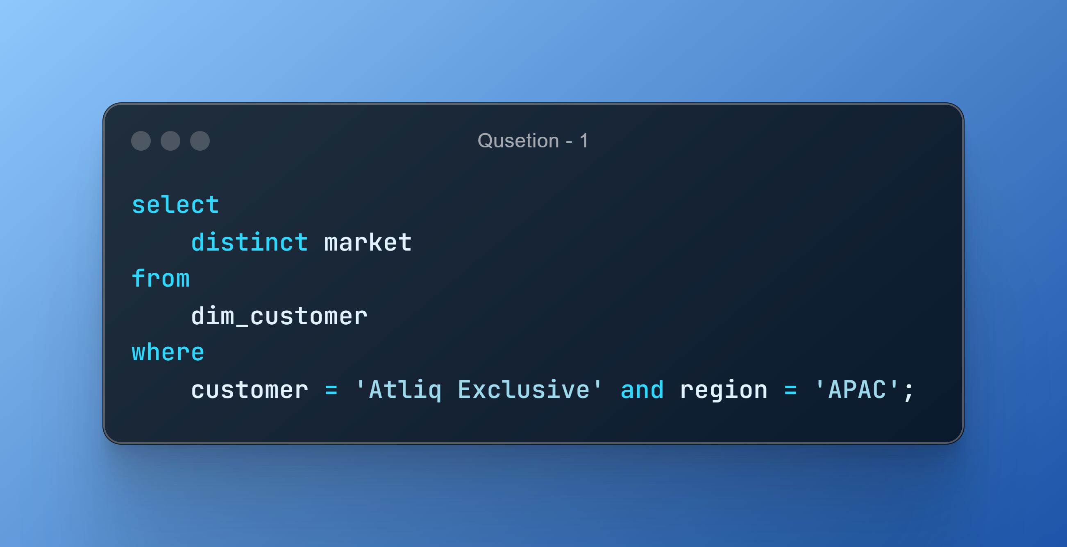
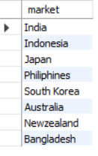
AD_HOC-REQUEST:1
QUESTION: Provide the list of markets in which customer "Atliq Exclusive" operates its business in the APAC region

Slide 8
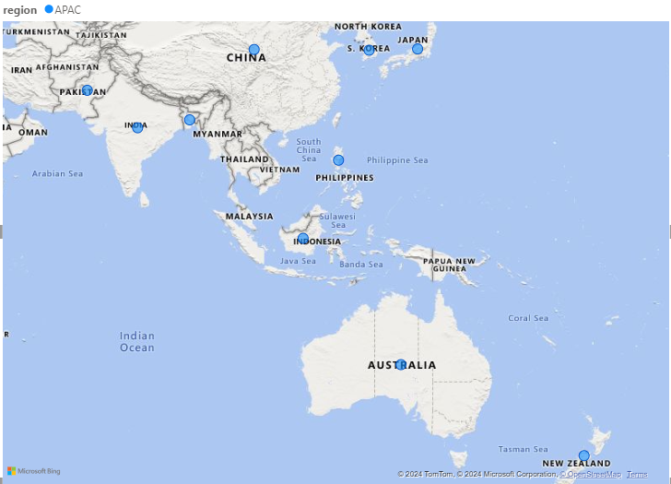
VISUALS- 1
Insights •"Atliq Exclusive" has a presence in several countries across the APAC region, including India, Indonesia, Japan, the Philippines, South Korea, Australia, New Zealand, and Bangladesh. •It reflects a robust market presence and adaptability to different cultural and economic contexts in the Asia-Pacific region.

Slide 9
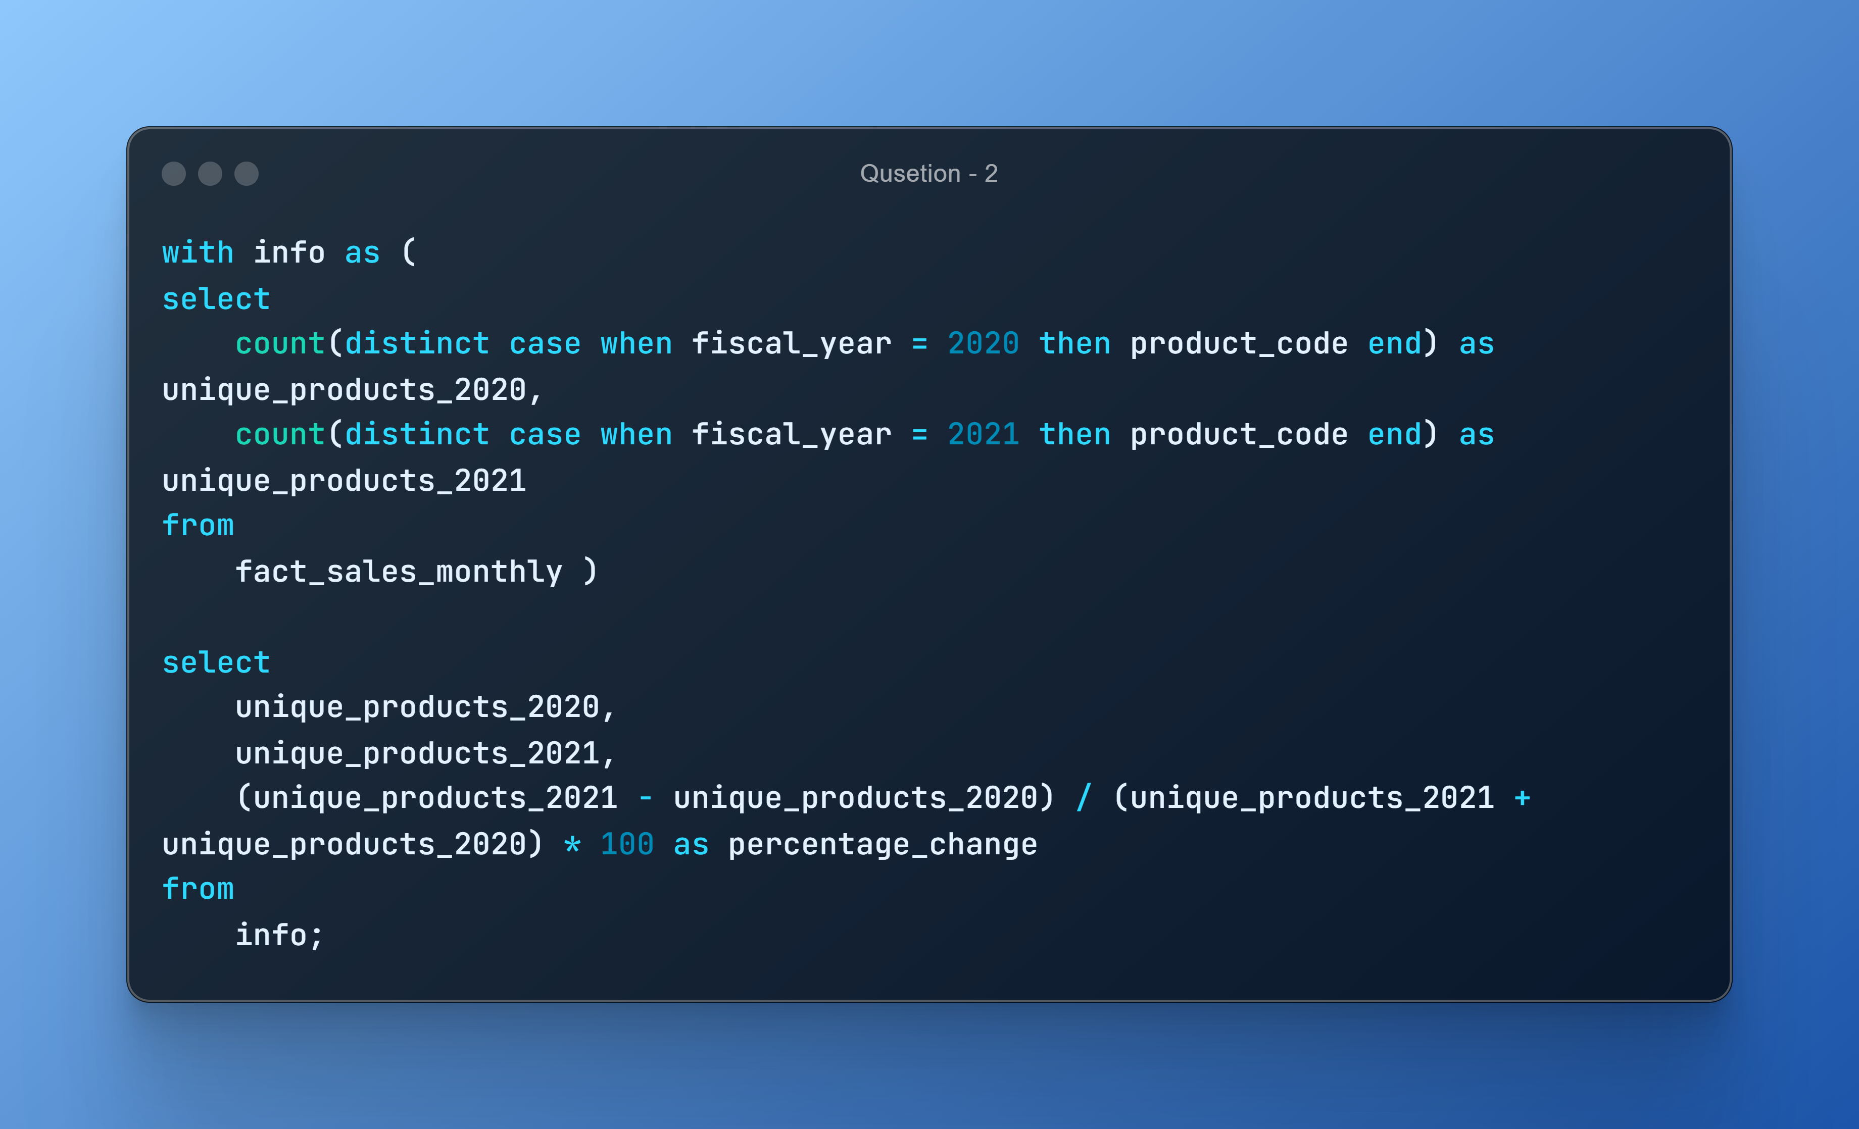
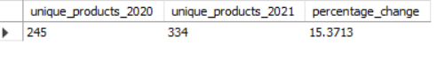
AD_HOC-REQUEST:2
QUESTION: What is the percentage of unique product increase in 2021vs. 2020?
Note Fiscal_year2019 is from sep2019 to aug2020 Fiscal_year2021 is from sep2020 to aug _2021

Slide 10
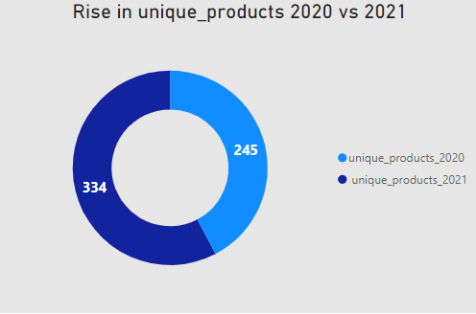
VISUALS-2
Insights •There was a significant increase in unique products, with 334 in 2021 compared to 245 in 2020. •The percentage change represents a growth of 36.33% in unique products from one year to the next. •This substantial increase in unique products suggests a focus on expanding product offerings, which can attract a broader customer base and potentially boost sales and revenue. •It's a positive indicator of business growth and adaptability to changing market demands.

Slide 11
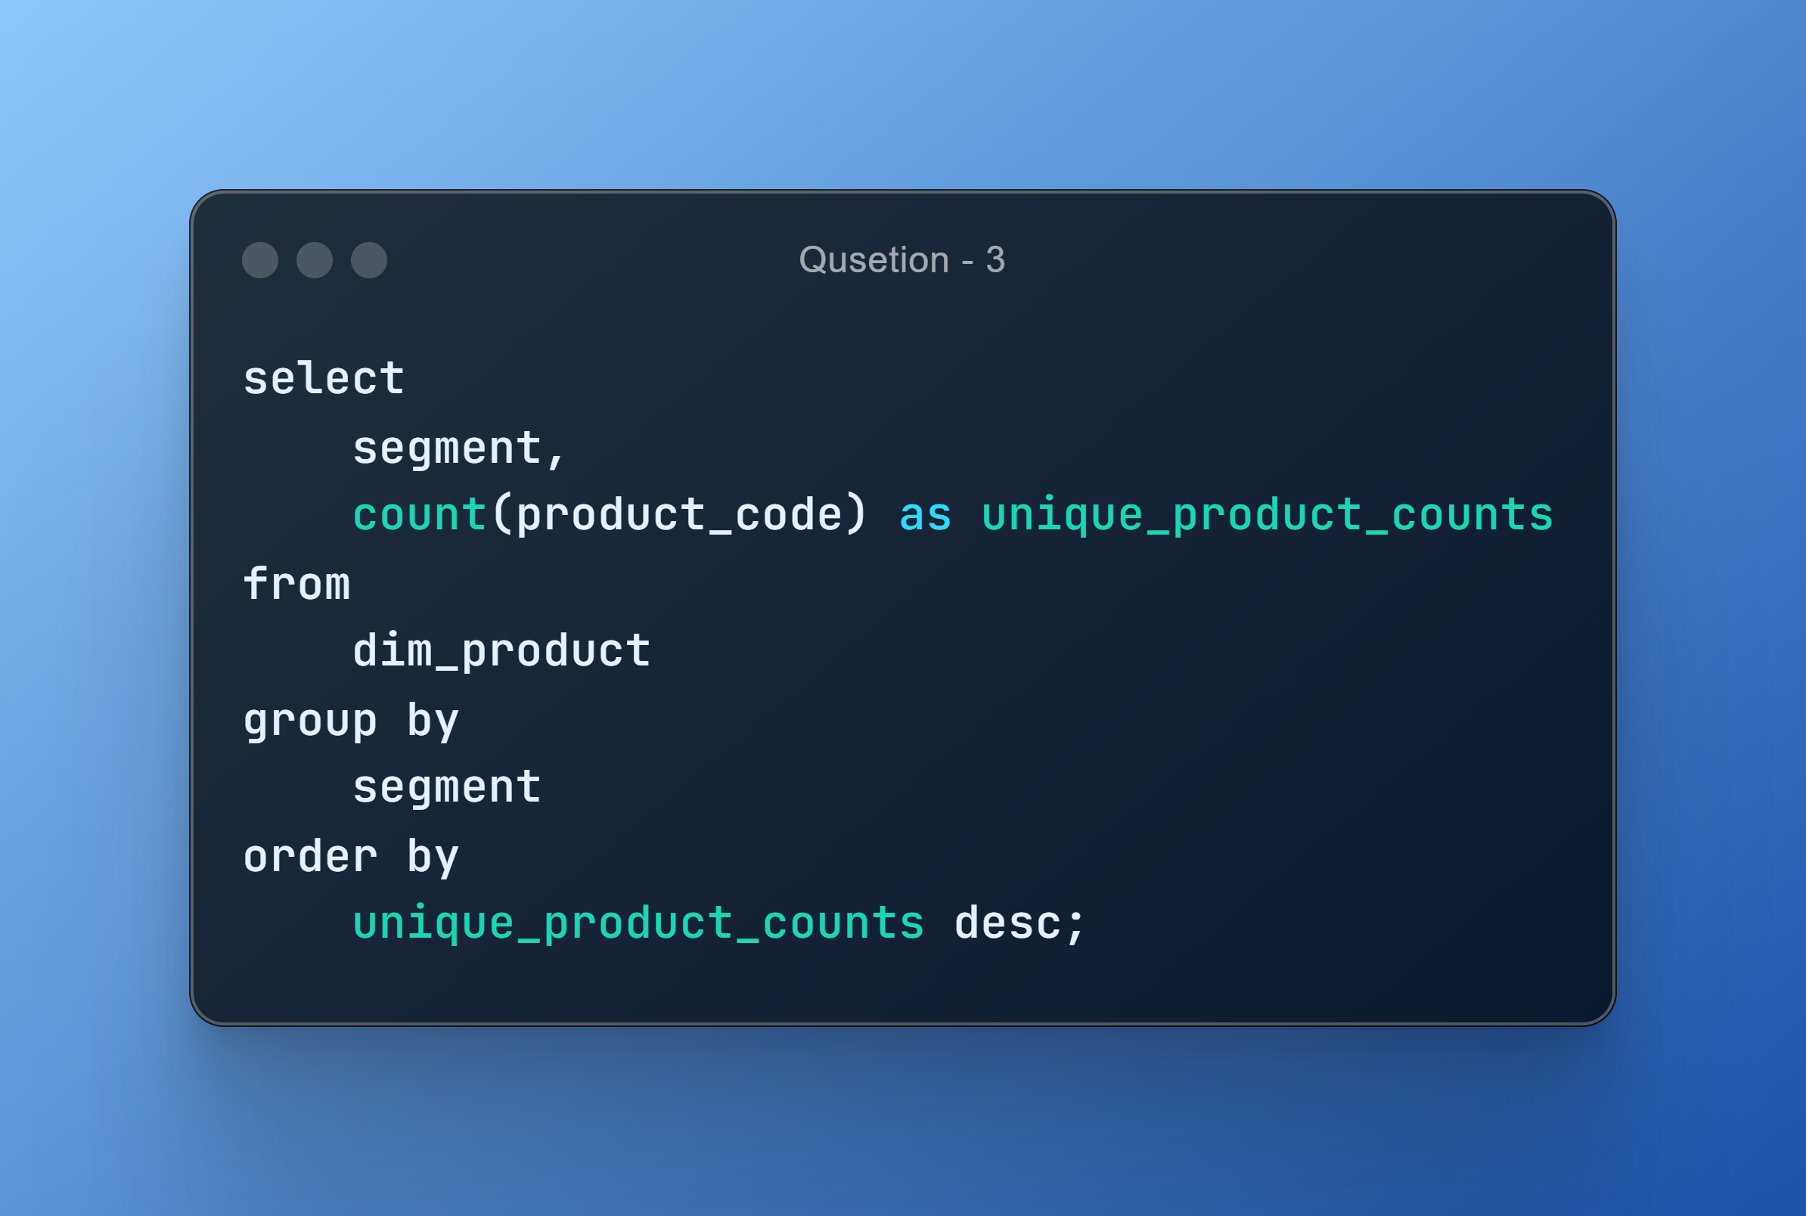
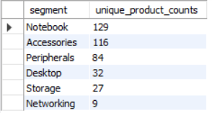
AD_HOC-REQUEST:3
QUESTION: Provide a report with all the unique product counts for each segment and sort them in descending order of product counts.

Slide 12
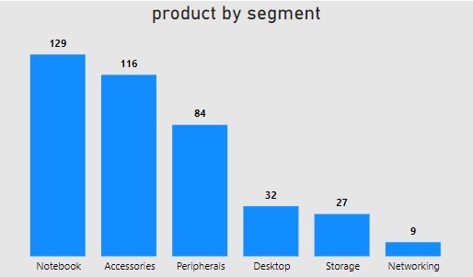
VISUALS- 3
Insights •The "Notebook" segment has the highest product count, with 129 products. •The "Networking" segment has the smallest product count with only 9 products. •These insights indicate the diversity and product offerings within each segment, with "Notebook" and "Accessories" offering a wide range of options, while "Networking" has a more limited selection. •The variety in product offerings allows catering to various customer preferences and needs across different segments.

Slide 13
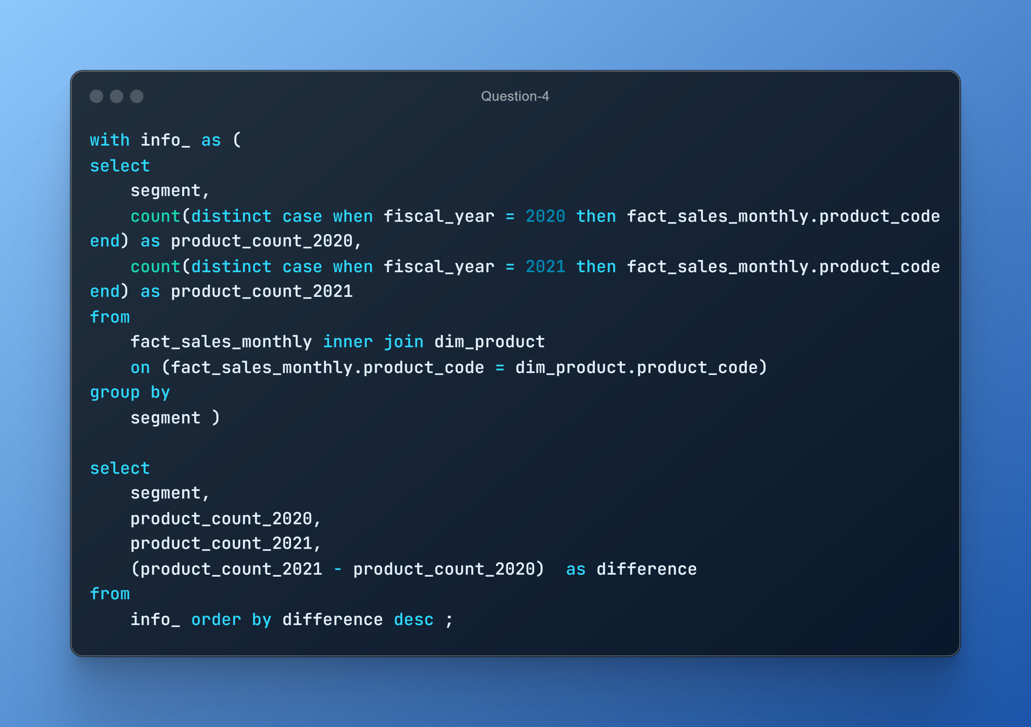
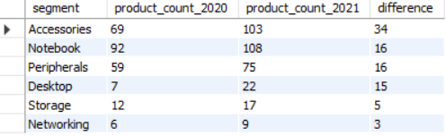
AD_HOC-REQUEST:4
QUESTION: Which segment had the most increase in unique products in 2021 vs 2020?

Slide 14
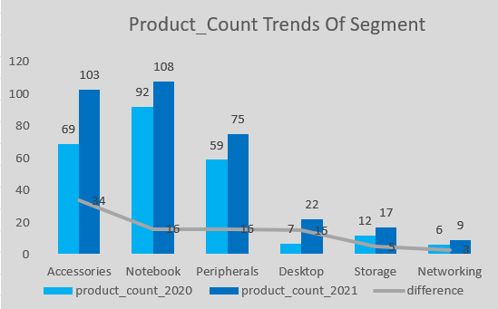
VISUALS- 4
Insights
• The "Accessories" segment saw a significant increase in product counts, with 34 more products in 2021 compared to 2020. • These insights suggest a general trend of product portfolio growth, particularly in the "Accessories" and "Notebook" segments, which can indicate a strategy to cater to a broader range of customer preferences. • The growth in product variety may enhance market competitiveness and offer customers more choices.

Slide 15
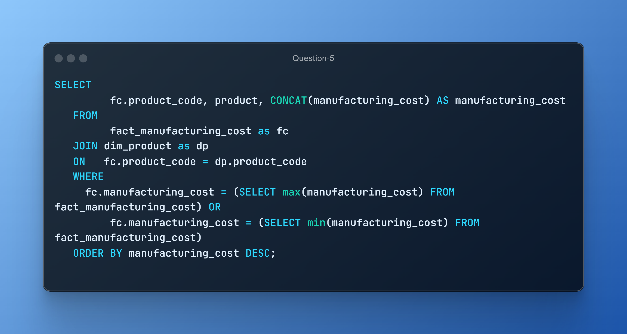
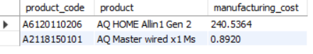
AD_HOC-REQUEST:5
QUESTION: Get the products that have the highest and lowest manufacturing costs.
Insights
•"AQ HOME Allin1 Gen 2" has a relatively higher manufacturing cost of 240.5364. •In contrast, "AQ Master wired x1 Ms" has a significantly lower manufacturing cost of 0.892

Slide 16
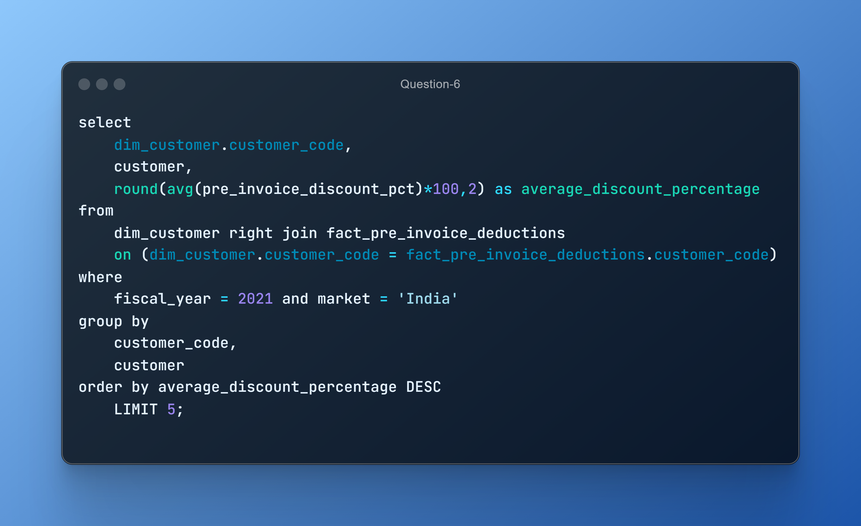
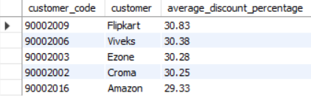
AD_HOC-REQUEST:6
QUESTION: Generate a report which contains the top 5 customers who received an average high pre_invoice_discount_pct for the fiscal year 2021 and in the Indian market.

Slide 17
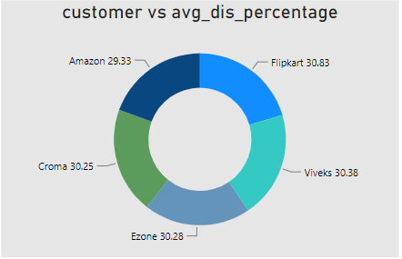
VISUALS- 6
Insights
• "Flipkart" has the highest average pre-invoice discount percentage at 30.83%. • "Amazon" has a comparatively lower average discount at 29.33%. • These insights indicate varying discount strategies among customers, with "Flipkart" and "Viveks" offering the highest average discounts, potentially attracting cost-conscious shoppers. • "Amazon" provides relatively lower discounts, suggesting a different pricing strategy or a customer base less sensitive to discounts. • These insights can be valuable for adjusting discount strategies and understanding customer preferences

Slide 18
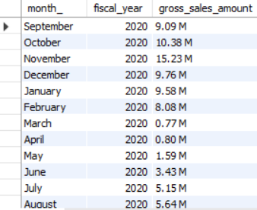
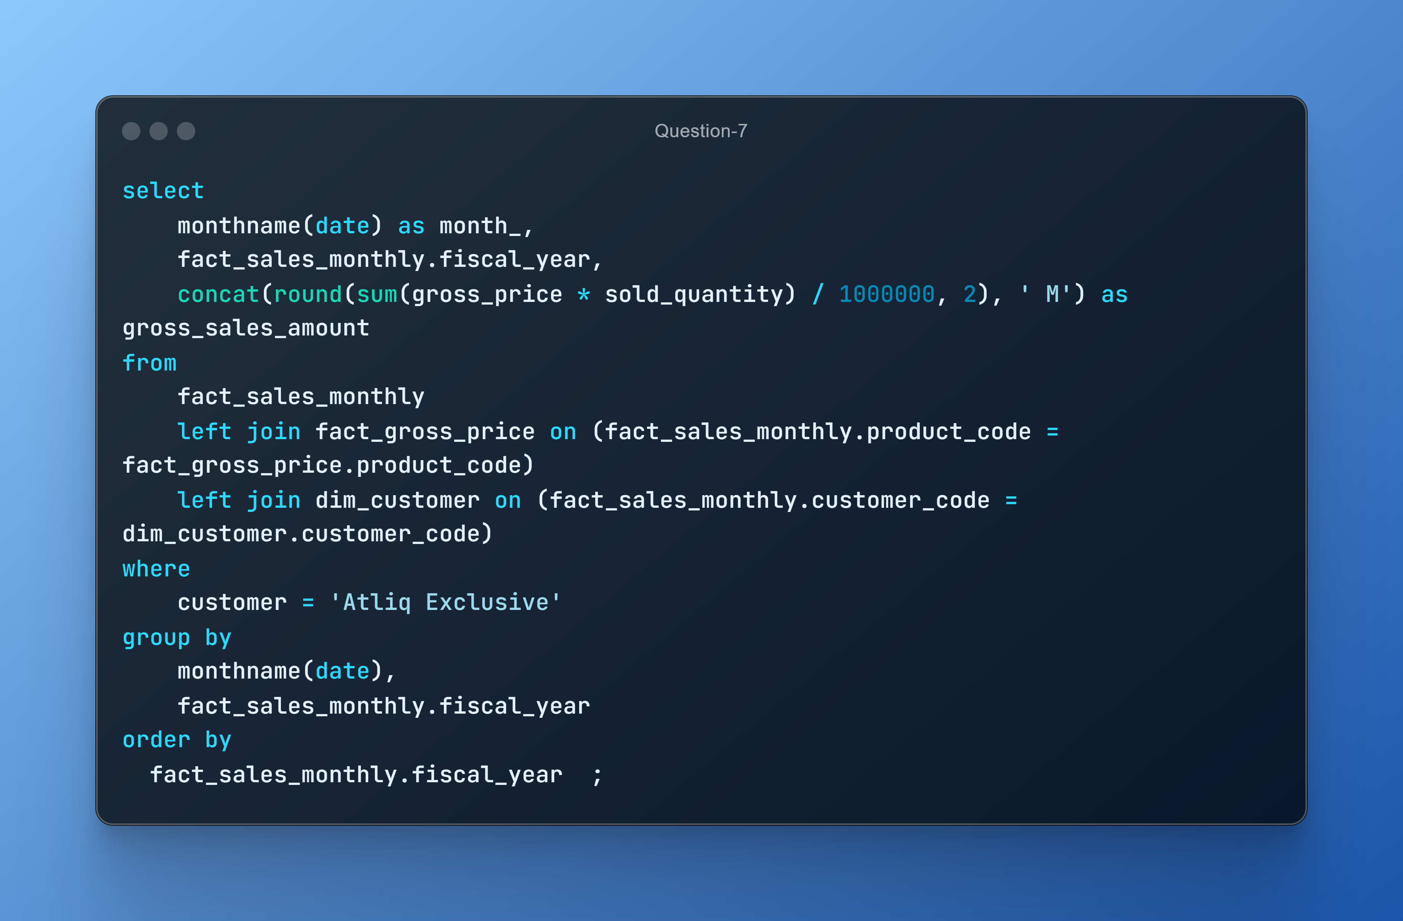
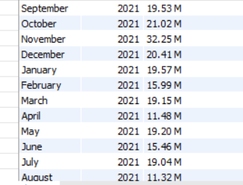
AD_HOC-REQUEST:7
QUESTION: Get the complete report of the Gross sales amount for the customer “Atliq Exclusive” for each month.

Slide 19
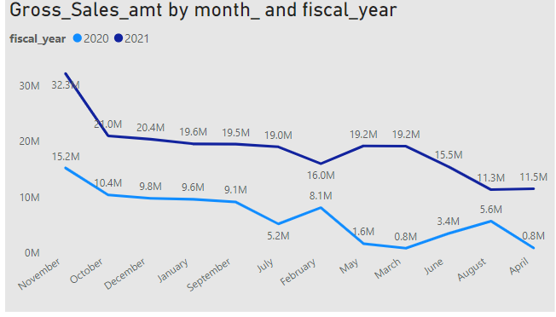
VISUALS- 7
Insights
•November 2021 had the highest gross sales amount, reaching $32,247,289.79. • In contrast, the fiscal year 2021 started with lower sales in September but still had a significant peak in November. • There is a notable seasonality in sales, with November being a consistently strong month. • The months of March and April in fiscal year 2020 had relatively low sales, which improved in fiscal year 2021. • These insights can guide strategic decisions, such as focusing marketing efforts and inventory planning around the peak sales months and addressing potential challenges during lower sales months.

Slide 20
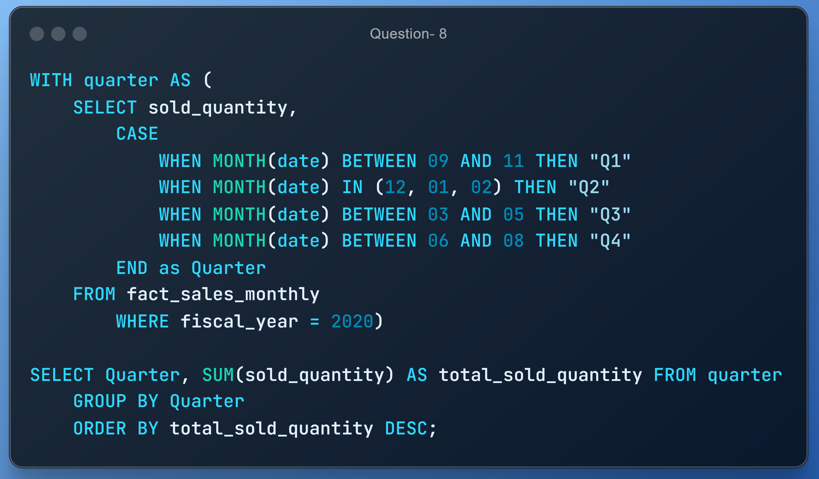
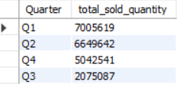
AD_HOC-REQUEST:8
QUESTION: In which quarter of 2020, got the maximum total_sold_quantity?

Slide 21
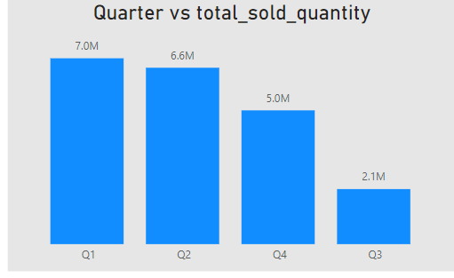
VISUALS- 8
Insights
• The highest total sold quantity is in Q1, with 7,005,619 units. • These insights highlight a seasonal variation in sales, with Q1 and Q2 being the strongest quarters and Q3 being the weakest. • This information is valuable for planning inventory and marketing strategies to align with seasonal demand

Slide 22
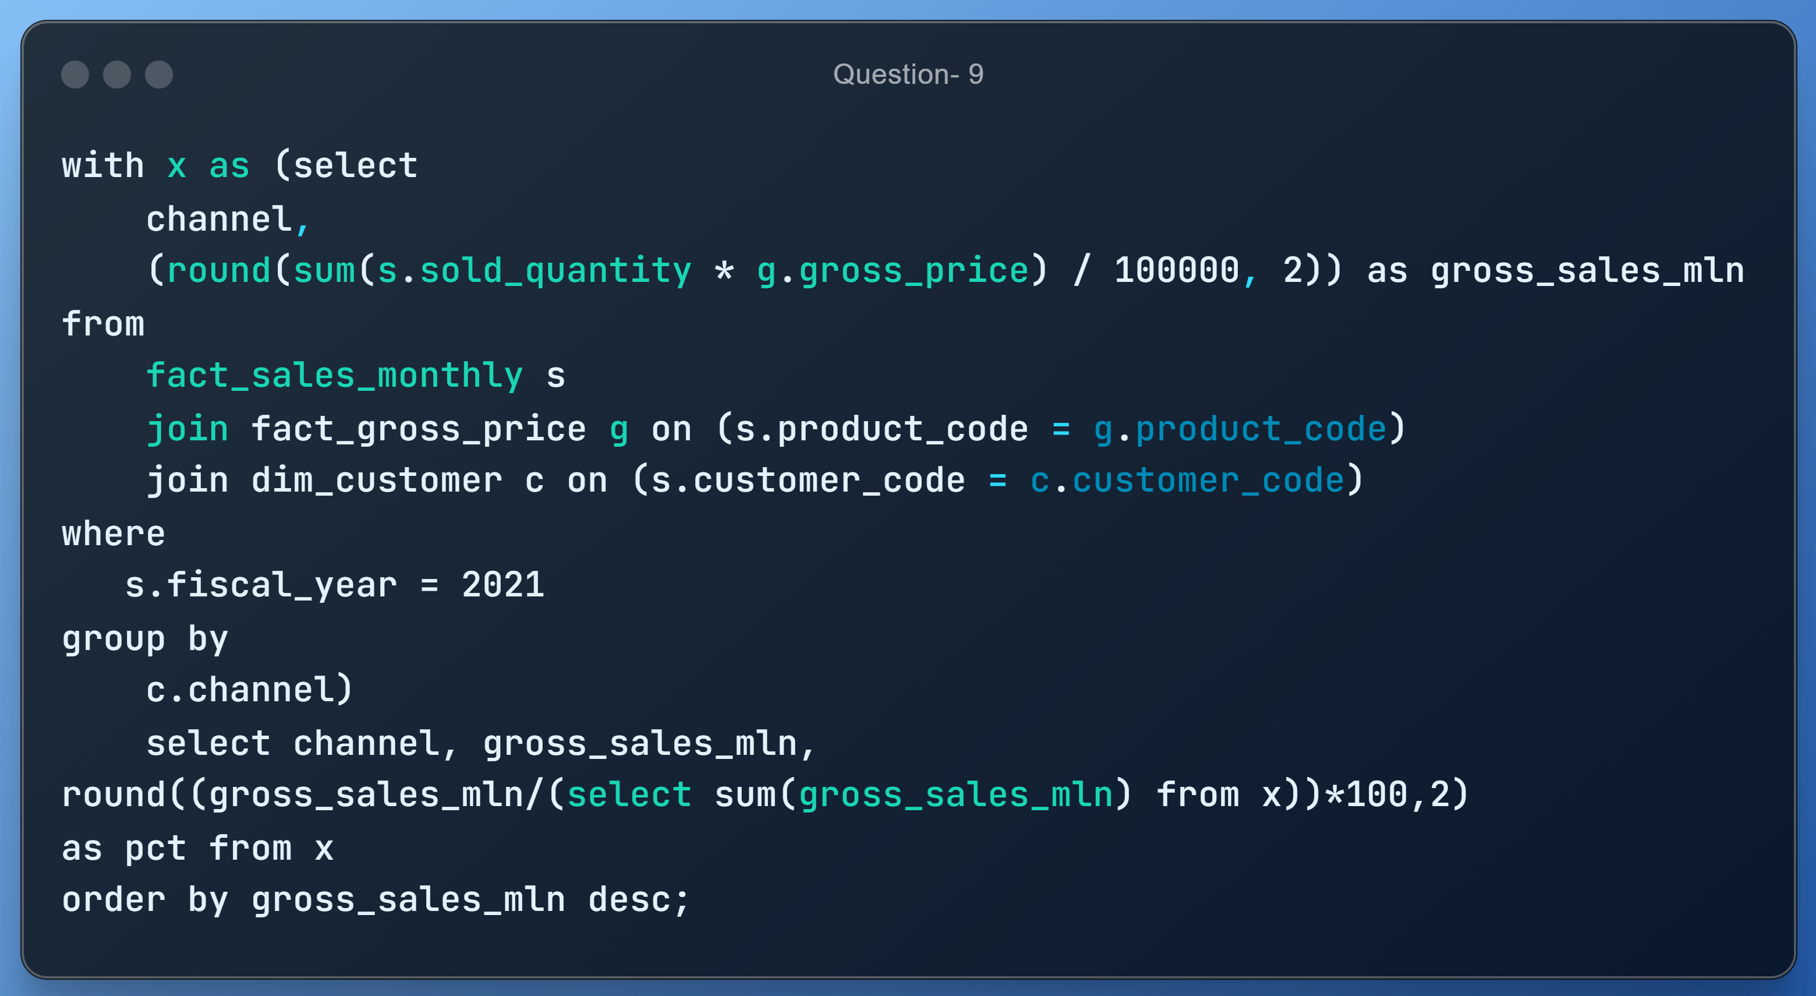
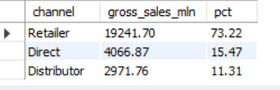
AD_HOC-REQUEST:9
QUESTION: Which channel helped to bring more gross sales in the fiscal year 2021 and the percentage of contribution?

Slide 23
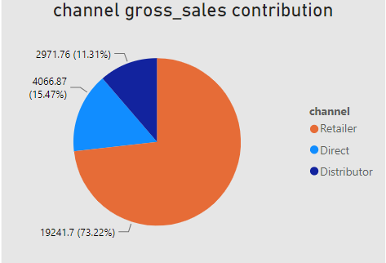
VISUALS- 9
Insights
•The "Retailer" channel accounts for the majority of sales, contributing to 73.22% of gross sales. • The "Direct" channel also plays a significant role, representing 15.47% of gross sales. • The "Distributor" channel contributes 11.31% of gross sales. • A significant focus on the "Retailer" channel suggests it is the primary revenue driver. • Diversification and growth opportunities may be explored in the "Direct" and "Distributor" channels to further maximize sales.

Slide 24
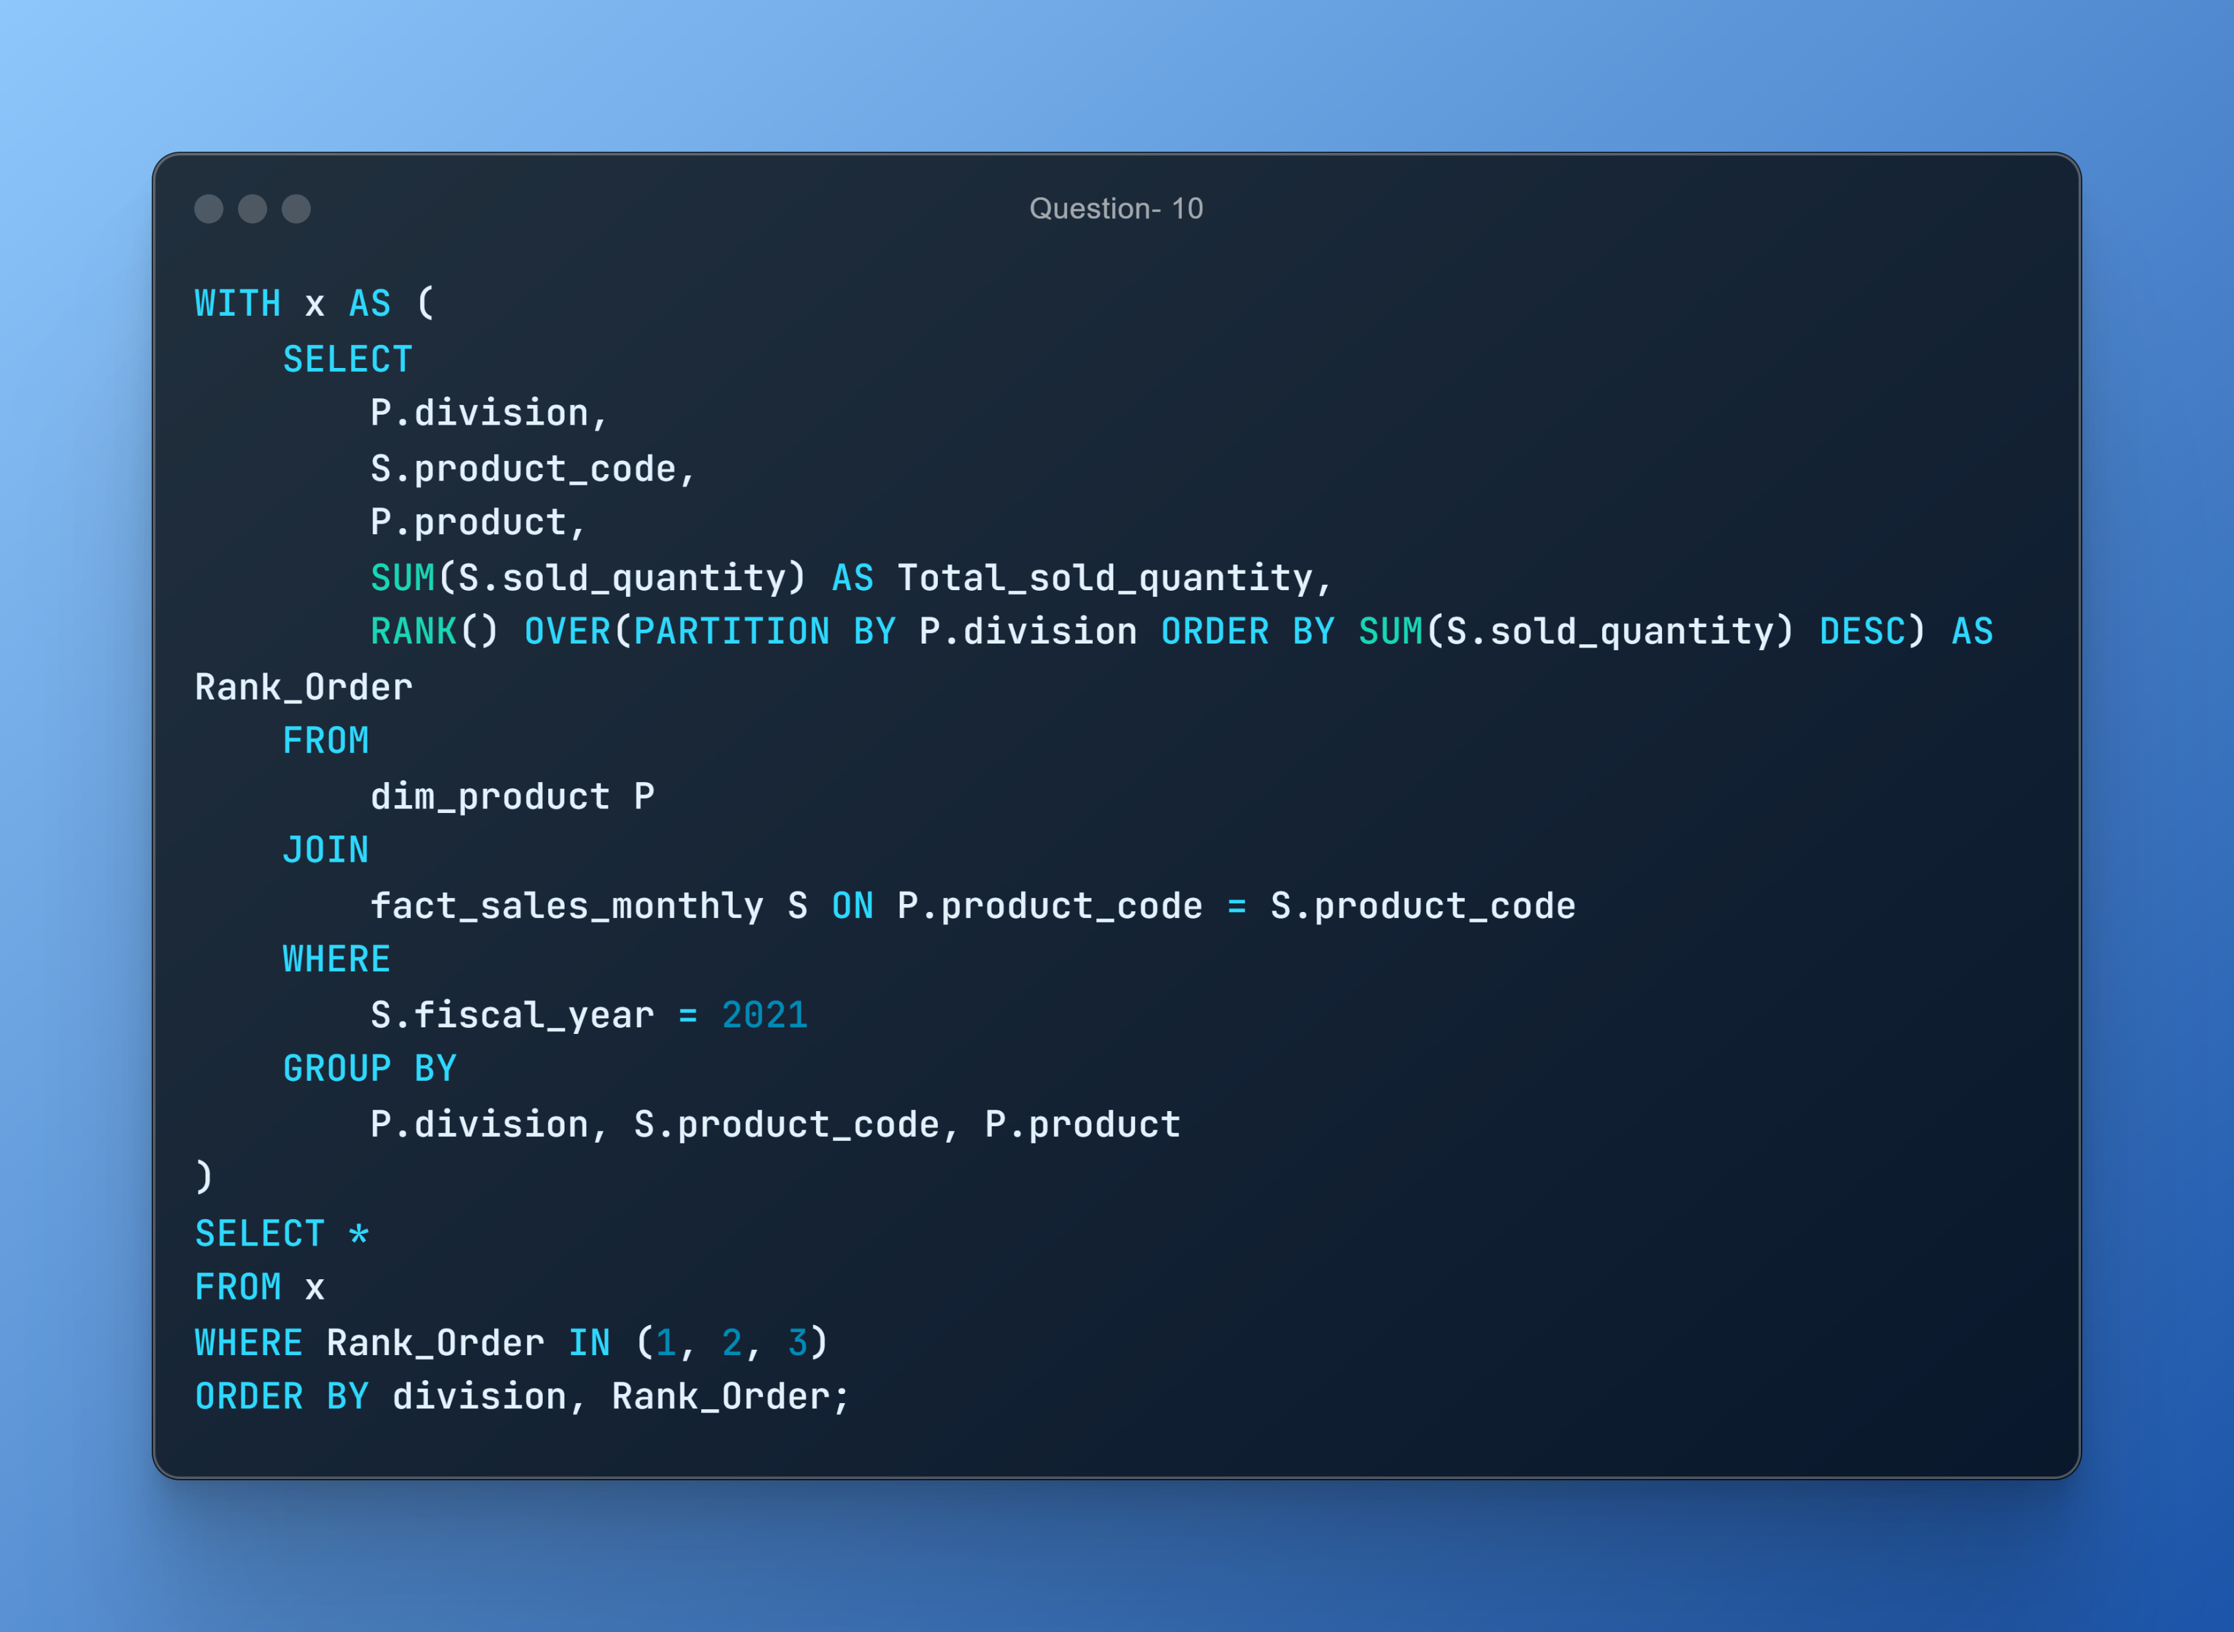
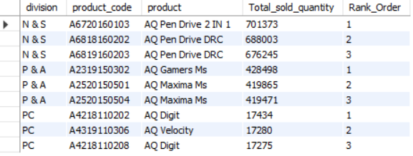
AD_HOC-REQUEST: 10
QUESTION: Get the Top 3 products in each division that have a high total_sold_quantity in the fiscal_year 2021?

Slide 25
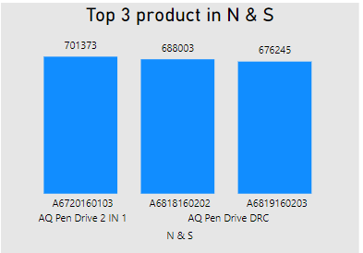
VISUALS - 10
Insights
• The top three products: "AQ Pen Drive 2 IN 1," "AQ Pen Drive DRC," and another variant of "AQ Pen Drive DRC Strong consumer preference for pen drives and related items in this division. • The division's leadership in this market segment, indicating growth potential. • Efficient inventory management is crucial for sustained success

Slide 26
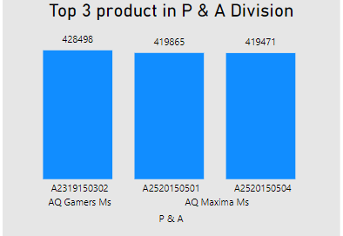
VISUALS - 10
Insights
• The best-selling product is "AQ Gamers Ms. " followed by two variants of "AQ Maxima Ms.“ • This division specializes in gaming-related products, appealing to a specific customer niche.. • Efficient inventory management is essential to meet customer demand. • Continuously promote and brand the top products to sustain success

Slide 27
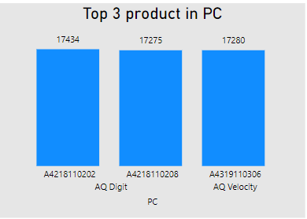
VISUALS - 10
Insights
• The best-selling product in the "PC" division is "AQ Digit," with two variants followed by “AQ velocity”. • The division specializes in PC-related products, indicating a focus on the computing niche. • Efficient inventory management is essential to meet customer demand. • Ongoing branding and marketing efforts are important to maintain success

Slide 28
Thank You

